Slide 1
205 Jan 31, Class 12
Chapter 10
2x2 results, main effects and interactions
Planning Experiment 2

Slide 2
Patterns of Results in 2x2 Designs
Simulated data
Factor 1 has two levels
Condition A, Condition B
Factor 2 has two levels
Condition X, Condition Y
Dependent variable is a measure on a 10-point scale
20 participants per condition

Slide 3
Data in a Means Table
Means Table |  | Factor 1
 |  | A | B | Mean
Factor 2 | X | 3.93 (1.43) | 4.21 (1.22) | 4.07 (1.33)
 | Y | 6.98 (1.28) | 6.88 (1.37) | 6.93 (1.33)
 | Mean | 5.45 (2.04) | 5.55 (1.86)

Slide 4
Data terms
Condition or cell means
Performance of the participants in specific conditions
AX, AY, BX, BY
Marginal means
Average performance of participants by factor
Factor 1: A vs B
Average(AX,AY) and Average (BX,BY)
Factor 2: X vs Y
Average(AX,BX) and Average (AY,BY)
Effect size
Difference in the marginal means across the factor
“Unstandardized” = actual DV difference

Slide 5
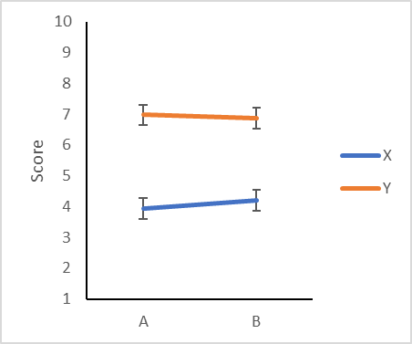
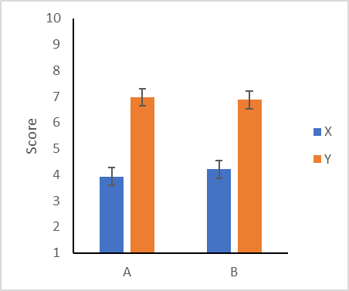
Data Visualization: Lines and Bars

Slide 6
Data 2
Means Table |  | Factor 1
 |  | A | B | Mean
Factor 2 | X | 3.27 (1.51) | 7.09 (1.35) | 5.18 (2.39)
 | Y | 3.65 (1.08) | 7.44 (1.44) | 5.55 (2.28)
 | Mean | 3.46 (1.33) | 7.26 (1.41)

Slide 7
Data 2

Slide 8
Data 3
Means Table |  | Factor 1
 |  | A | B | Mean
Factor 2 | X | 2.36 (1.54) | 4.70 (1.54) | 3.53 (1.93)
 | Y | 4.00 (1.08) | 6.38 (1.44) | 5.19 (1.84)
 | Mean | 3.18 (1.63) | 5.54 (1.74)

Slide 9
Data 3

Slide 10
Data 4
Means Table |  | Factor 1
 |  | A | B | Mean
Factor 2 | X | 1.43 (1.32) | 4.43 (2.00) | 2.93 (2.26)
 | Y | 3.56 (1.39) | 9.31 (1.38) | 6.43 (3.19)
 | Mean | 2.50 (1.72) | 6.87 (2.98)

Slide 11
Data 4

Slide 12
Data 5
Means Table |  | Factor 1
 |  | A | B | Mean
Factor 2 | X | 6.70 (1.76) | 4.34 (1.58) | 5.52 (2.04)
 | Y | 3.92 (1.42) | 4.51 (1.29) | 4.21 (1.39)
 | Mean | 5.31 (2.11) | 4.43 (1.45)

Slide 13
Data 5

Slide 14
Data 6
Means Table |  | Factor 1
 |  | A | B | Mean
Factor 2 | X | 3.29 (1.07) | 5.87 (1.54) | 4.58 (1.85)
 | Y | 6.59 (1.63) | 3.20 (1.31) | 4.90 (2.25)
 | Mean | 4.94 (2.15) | 4.53 (1.96)

Slide 15
Data 6

Slide 16
2x2 Data
Main effects
Factor 1: effect on performance ignoring Factor 2
Factor 2: effect on performance ignoring Factor 1
Possible outcomes: both, either one alone, or neither
Interactions
The factors affect each other
The effect of Factor 1 was different across levels of Factor 2
The effect of Factor 2 was different across levels of Factor 1
“Different”
Accelerator: super-additive factors
Reducer: can give a 3:1 shape
Inverter: effect goes in different directions

Slide 17
Types of 2x2 designs
Two manipulated factors, between participants
Experimenter assigns participants to one of the four conditions
One manipulated factor, one participant variable
Measure or recruit based on participant variable
Split into 2 groups by median or pre-defined criterion
Random assignment across manipulated factor
Two within-participant factors
Participants each do all four conditions, counterbalanced order
One within-participant factor, Repeated Measures
Participants randomly assigned to AX,AY or BX,BY
Order counterbalanced
Mixed-model design

Slide 18
Order effects in within-participants design
In a simple 2 group within-participants study, participants complete both conditions of the experiment, order counterbalanced
A versus B
If order substantially affects the DV, the design has accidentally become a mixed-model 2x2
Factor 1: A, B
Factor 2: Order 1 (X), Order 2 (Y)
Observing an interaction complicates the inference

Slide 19
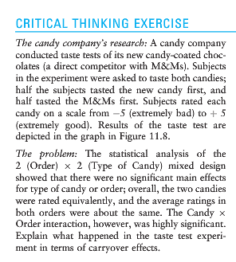
Taste test

Slide 20
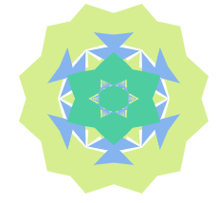
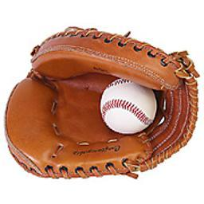
Experiment 2 Design
 |  | Meaningful
 |  | Abstract | Object
Encoding | Shallow | Color? | Color?
 | Deep | Liking? | Liking?

Slide 21
Experiment 2
Feedback & Suggestions?
Hypotheses/Predictions
What might be the main effect of Meaning?
What might be the main effect of Encoding?
What interactions might we see?

Slide 22
For Fri Feb 2
Chapter 11: External Validity, Sampling
Short introduction to the general idea
Assefi & Garry (2003). More 2x2 design practice.
Collect data for Experiment 2
Try to get 4 people to volunteer to try the study
Submit completion codes if they provide them
Deadline: Friday night? Sunday?

Slide 23
The grass is always greener on the other side
Design a 2x2 between-participants factorial experiment to test the everyday meaning of this aphorism.
Use subjects high and low in optimism as one factor in the design.
Give predicted results consistent with the idea that the grass on the other side will look greener and it will look particularly greener to optimists.

Slide 24
 | Near | Far
Optimists
Pessimists
6.5
9.7
6.5
8.2

Slide 25
Absolut Memory Distortions
Can the simple suggestion that you have consumed alcohol affect your memory for an event? Alcohol placebos affect social behaviors, but not non-social ones, and have not previously been shown to affect memory. We investigated the effect of alcohol placebos using materials that revealed both the social and the nonsocial influences of memory. Subjects drank plain tonic water, but half were told it was a vodka and tonic; then all subjects took part in an eyewitness memory experiment. Subjects who were told they drank alcohol were more swayed by misleading postevent information than were those who were told they drank tonic water, and were also more confident about the accuracy of their responses. Our results show that the mere suggestion of alcohol consumption may make subjects more susceptible to misleading information and inappropriately confident. These results also provide additional confirmation that eyewitness memory is influenced by both nonsocial and social factors.

Slide 26
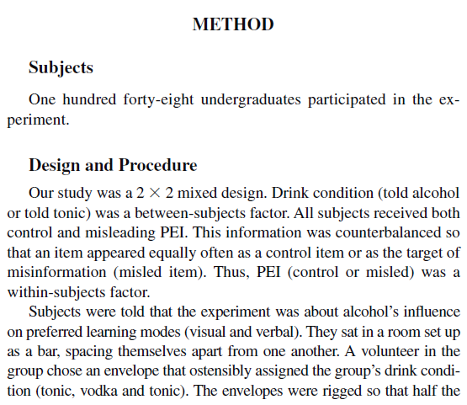
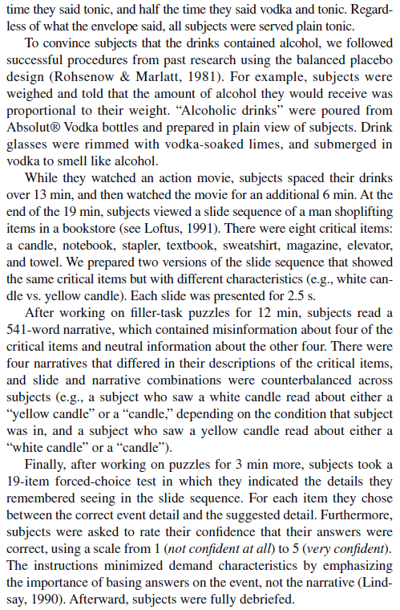

Slide 27
Diagram
2x2 mixed design
Placebo/control between groups
Misleading/control information within groups
148 original participants (31 eliminated)
74 subjects per group planned
 | Misleading PEI | Control PEI
Alcohol placebo | N=74 1.45 | N=74 2.45
Control | N=74 1.80 | N=74 2.50

Slide 28
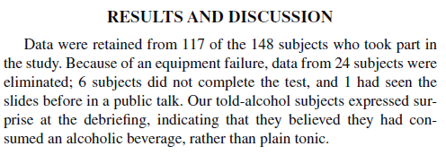
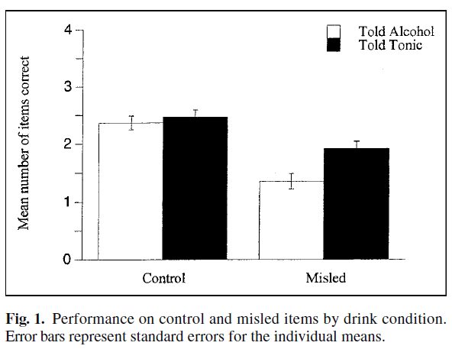

Slide 29
